Slide 1
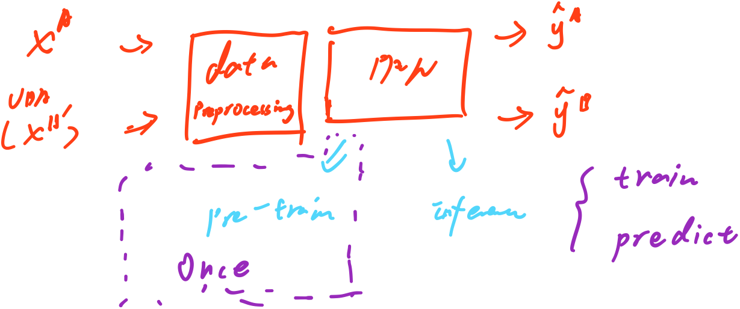

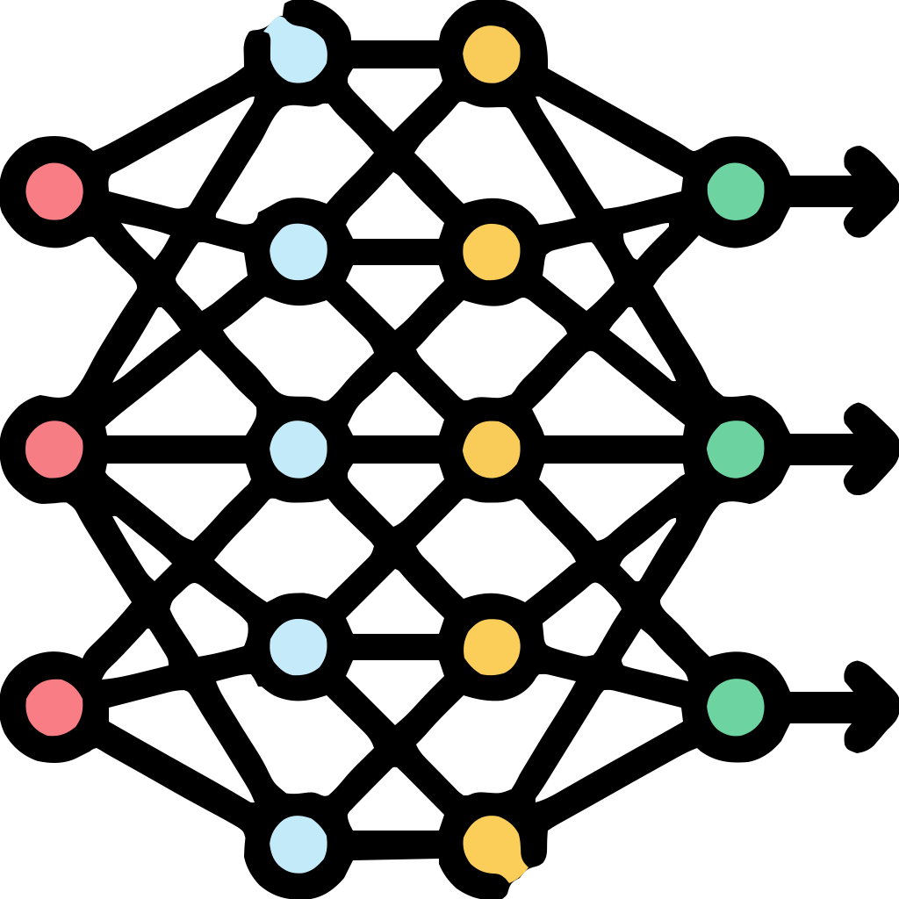
















Patients
Features
Development Cohort (Cohort A)
Pre-trained Tabular Foundation Model
Output Predicted
Class Probabilities
Patients
Features
Adapted Cohort
(Cohort B‘)
b
Data Preprossing

Slide 2

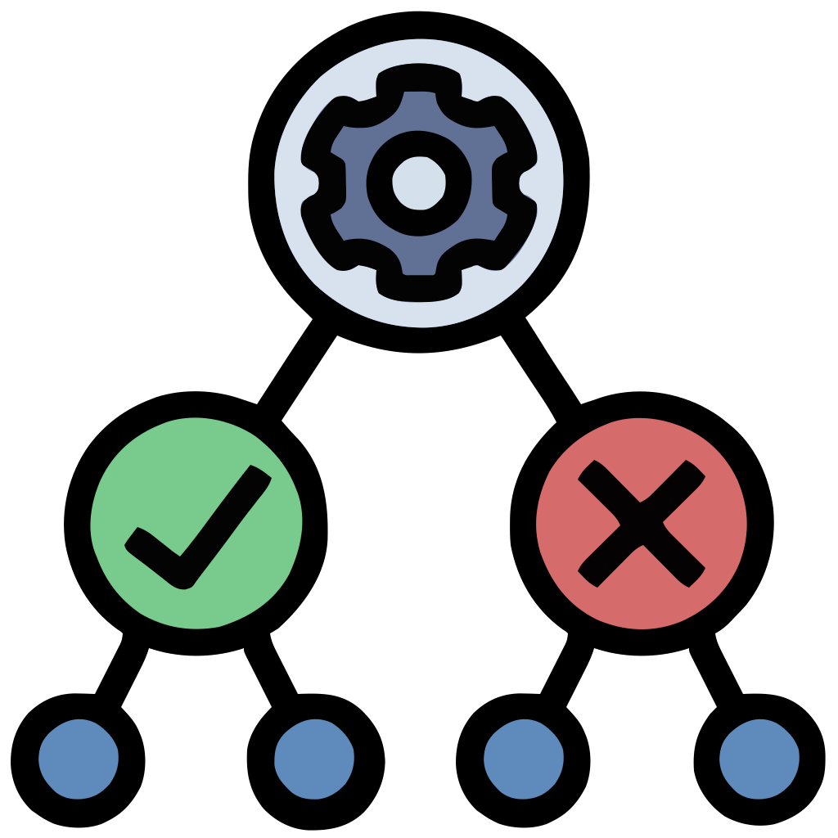



a
PANDA
Train
Output Predicted
Class Probabilities
Patients
Feature Selection
Features + Label
Development Cohort (Cohort A)
Patients
Data Preprocessing
Pre-trained Tabular Foundation Model
Features
Pre-train
UDA
Adapted Cohort
(Cohort B’ without label)
Predict
Synthetic task generator
Synthetic Dataset
b
Data Preprocessing
Input data

Slide 3





a
Feature Selection
Patients
RFE +
Patients
Features + Label
Features + Label
Original Cohort A
Development Cohort (Cohort A)
Patients
Pre-trained Tabular Foundation Model
Patients
Features + Label
Features + Label
b
Original Cohort B
Validation Cohort
(Cohort B)
UDA
Patients
Features
Development Cohort (Cohort A without label)
Patients
Unsupervised Domain Adaptation
Features
Patients
Adapted Cohort
(Cohort B’ without label)
Features
Validation Cohort
(Cohort B without label)
c
Pre-train

